Slide 1
Introduction to Social Sequence Analysis
Theory and applications
2023 by Xuewen Yan

Slide 2
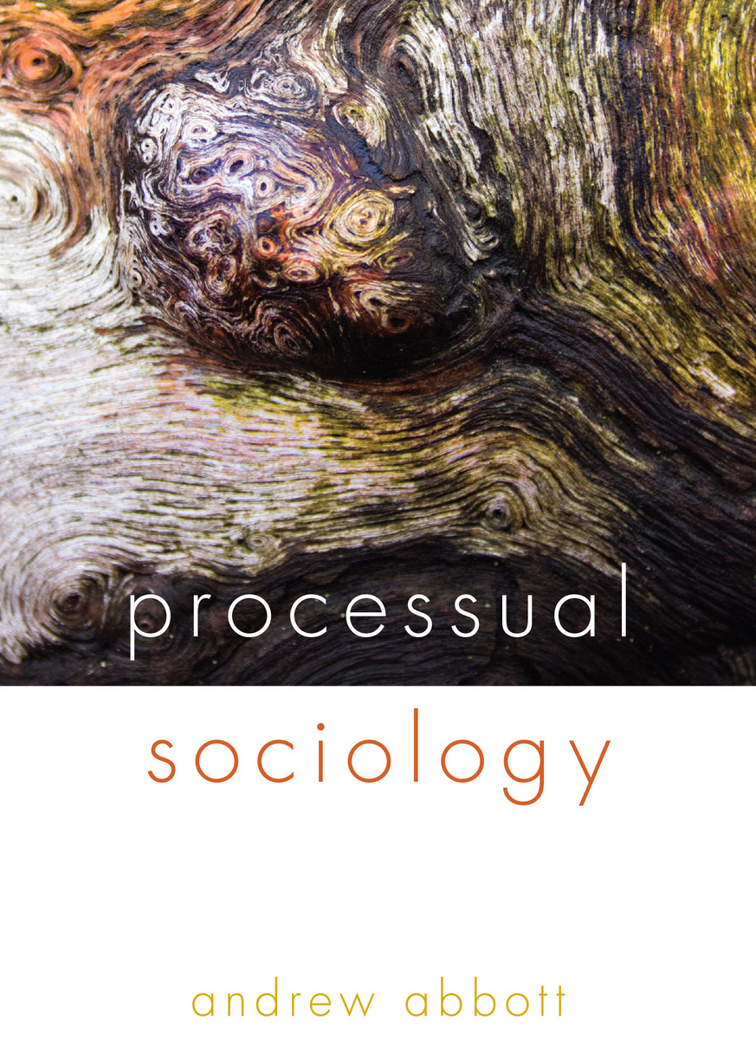
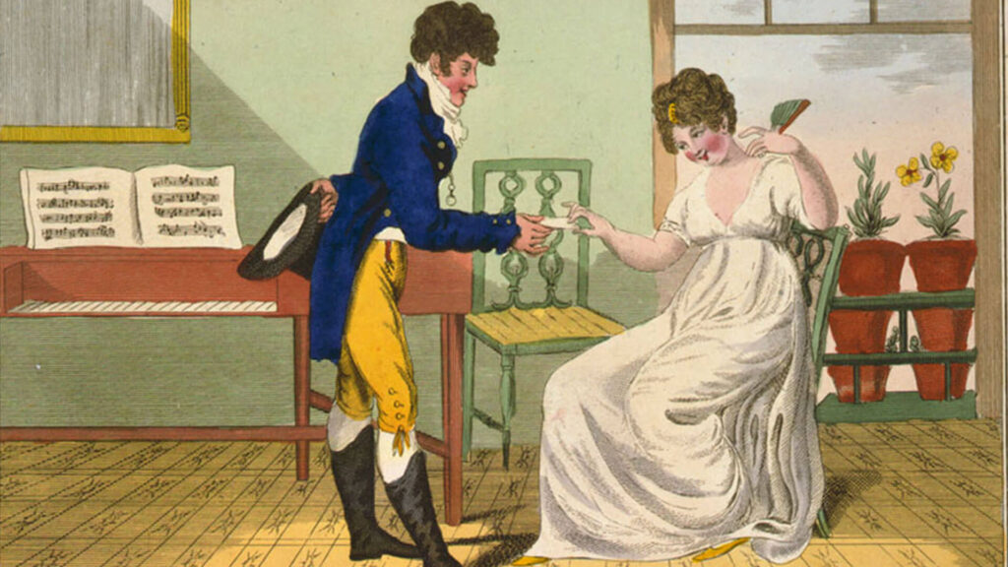
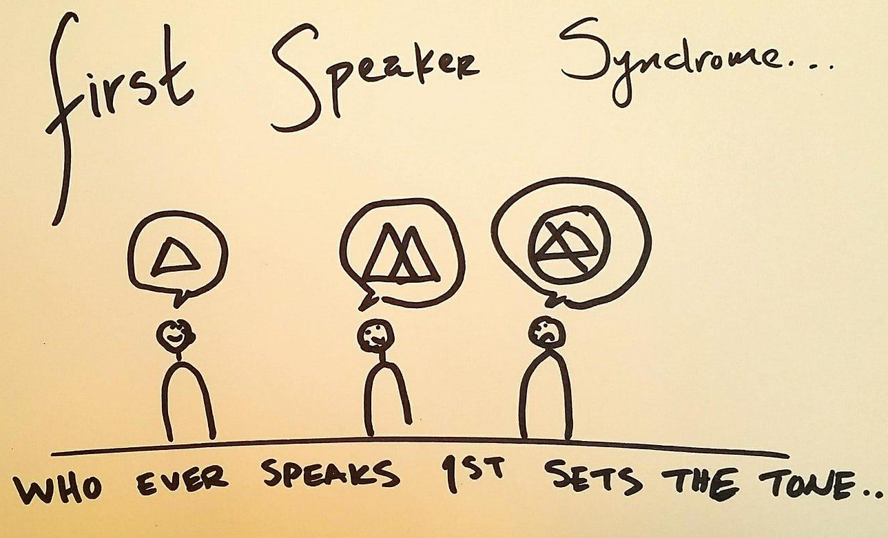
Why care about sequences in social life?
Notes:
We have a lot of ground to cover today –

Slide 3
Why care about sequences in social life?
Connection between events (/states/ phenomena)
Order of events
Timing of events
Duration of events
Occurrence of events

Slide 4
Sequence examples
Life course processes
Occupation/employment: Unemployed → OccA1 → Unemployed → OccB1 → OccB2 → OccB1 → Out of the labor force
Family formation: Single → Partnered → Single → Partnered → Married → Children
Life transitions: Schooling → Military → Employed → House purchase → Marry → Childbirth
Time use
Sleep → Shower → Eat → Relax → Commute → Interact → Work → Eat → Relax → Work → Interact
Event development
Relationship progression: Go on date → Hold hands → Kiss → Meet friends → Meet parents → “Love you” → Marriage → Sex
Narratives (for historical social analysis)
Anything that’s explicitly or implicitly ordered: preferences; rank orders; locations

Slide 5
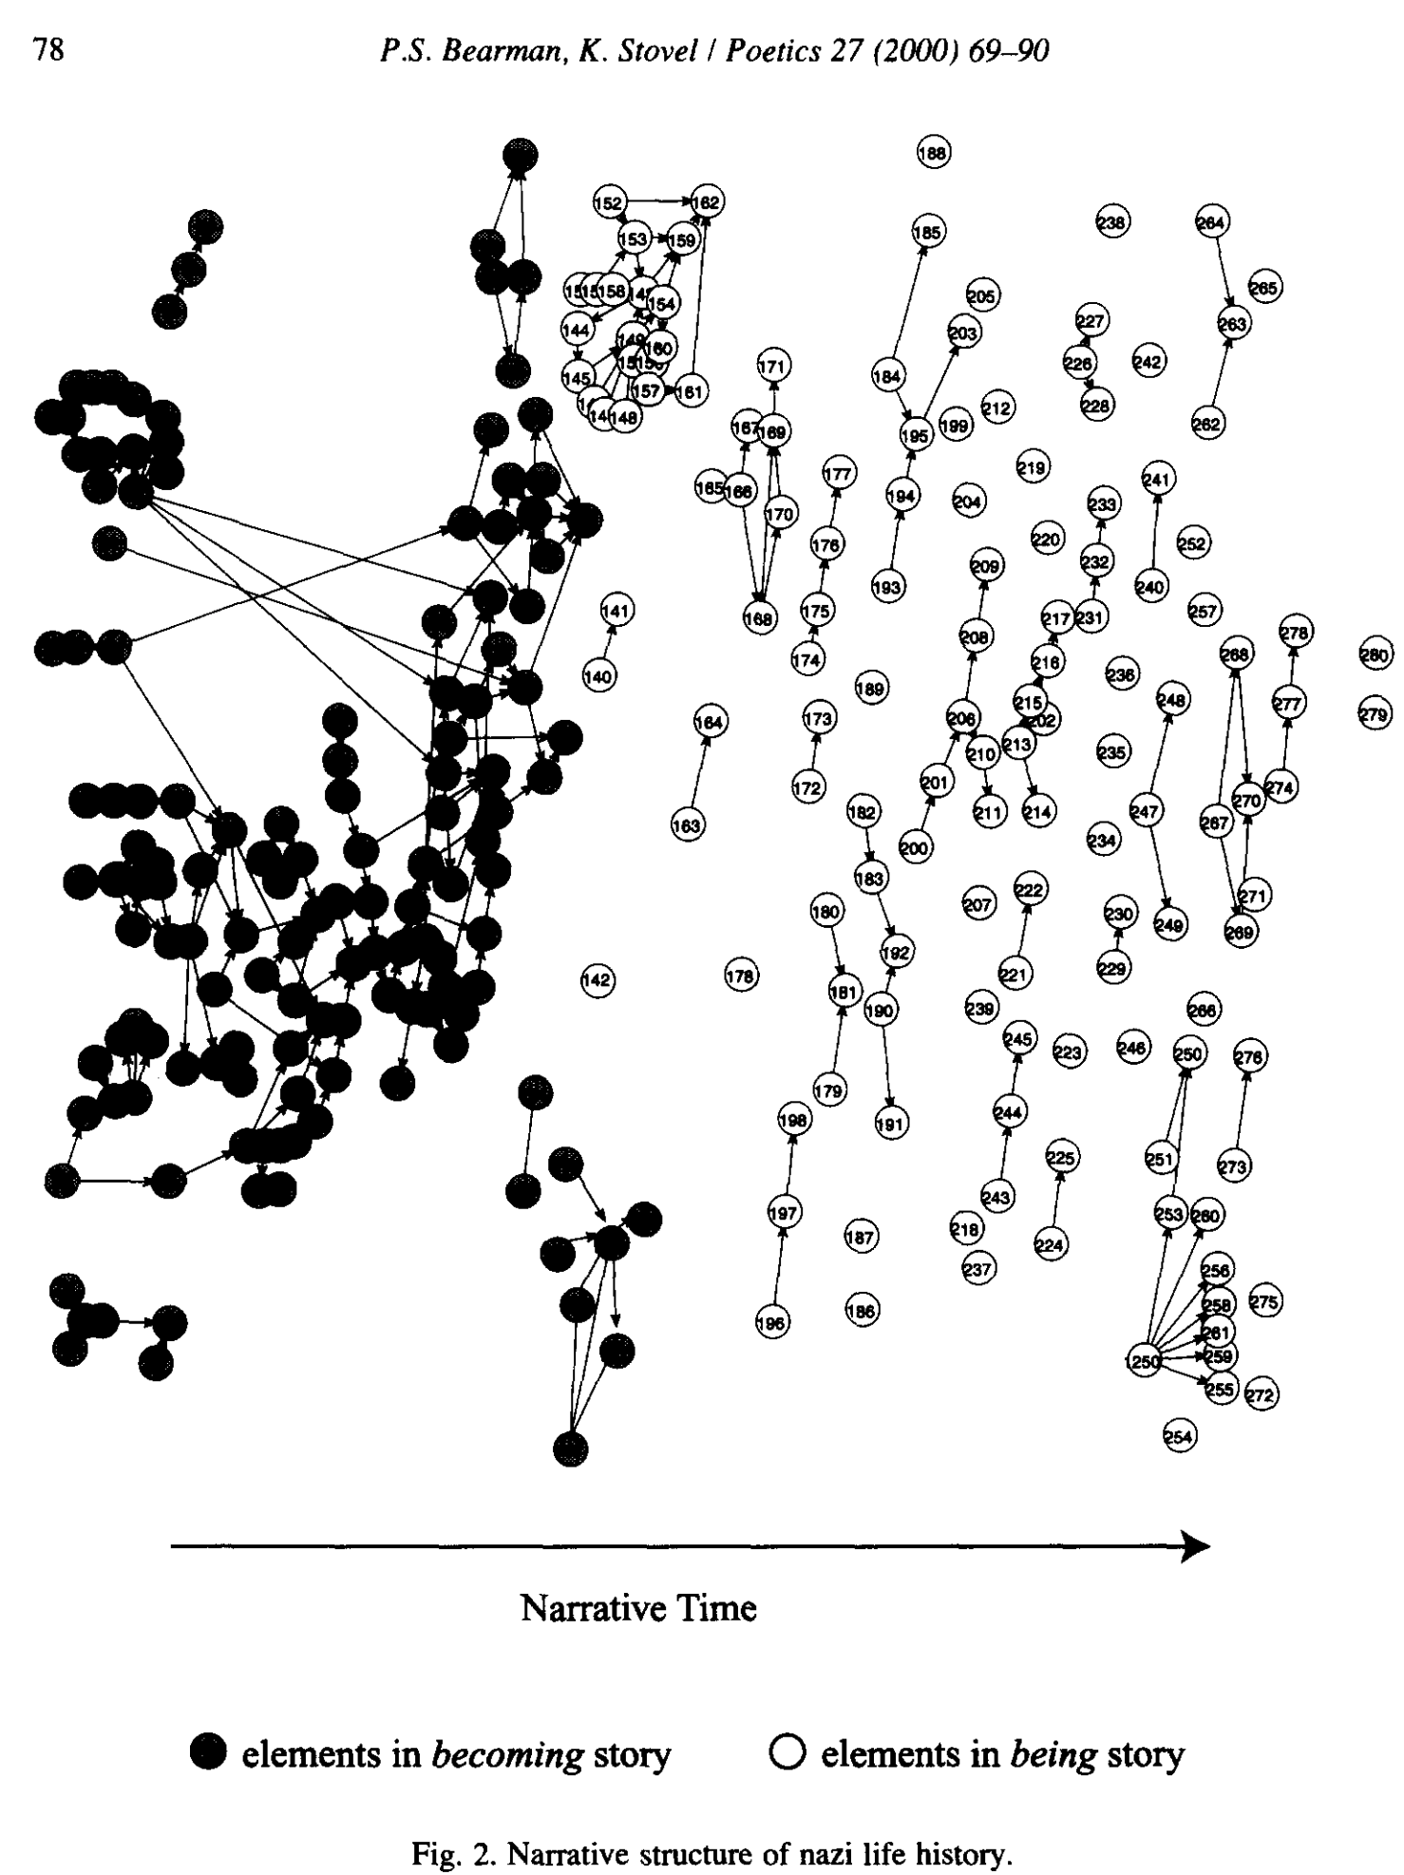
Job ad for postdoc:
Ph.D. in computational social science (e.g., sociology, management, economics, political science), complex systems (e.g., physics, ecology), network science, computer science, applied mathematics, statistics, or related fields.
Journal submission guideline:
Manuscripts of all types of sociological scholarship are welcome, including but not restricted to interview-based and observational ethnography, comparative historical analysis, lab and field experiments, computational modeling and simulation, textual analysis, formal theory, and quantitative statistical analyses.
Bearmand and Stovel, 2000 “Becoming a Nazi”

Slide 6
Goals in sequence analysis
Sequence description (can be useful on its own)
Describe and visualize the distribution of the composition of the sequences under study
Sequence comparison and clustering (core)
Compare different sequence patterns
Classify sequences into groups according to (dis)similarities between sequences
Common further steps
Visualizations/descriptions based on clustered sequences
Use sequence analysis results (e.g., clustering, various summary stats) for regression analysis (as dependent or independent variable)

Slide 7
Goals in sequence analysis
“to study a complex set of life-course trajectories as they actually take place, providing ideal types of trajectories that can be interpreted and analysed in a meaningful way” (Aassve et al. 2017)

Slide 8
Goals in sequence analysis
“to study a complex set of life-course trajectories as they actually take place, providing ideal types of trajectories that can be interpreted and analysed in a meaningful way” (Aassve et al. 2017)
The “TraMineR” R package name stands for "Life Trajectory Miner for R (and was inspired by the authors' taste for Gewürztraminer wine).
https://traminer.unige.ch/doc/00Index.html

Slide 9
Defining a sequence
Positions: Points, times, levels, or places at which a given sequential event is observed
Elements: Events, states or other phenomena that are observed in some order for each subject (always categorical!)
Element universe: entire set of elements that can be observed (must be conceptualized clearly during research!)
Spells/episodes: A set of contiguous positions that all contain the same element.
Year | t1 | t2 | t3 | t4 | t5 | t6 | t7 | t8 | t9
Id1 | Single | Single | Single | LAT | LAT | LAT | MAR | MAR-C | MAR-C
Age | 20 | 21 | 22 | 23 | 24 | 25 | 26 | 27 | 28
Id1 | Single | Single | Single | Rel1 | Rel1 | Rel2 | MAR | MAR-C1 | MAR-C2

Slide 10
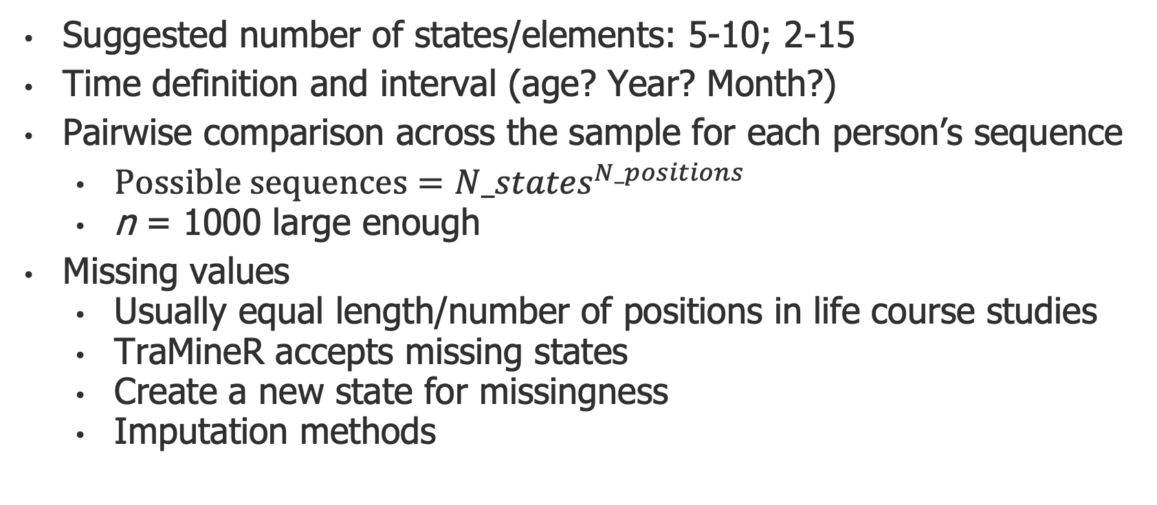
Defining a sequence: substantive meaning & computational power
Suggested number of states/elements: 5-10; 2-15
Time definition and interval (age? Year? Month?)
Pairwise comparison across the sample for each person’s sequence
$Possible sequences={N_states}^{N_positions}$
n = 1000 large enough
Missing values
Usually equal length/number of positions in life course studies
TraMineR accepts missing states
Create a new state for missingness
Imputation methods
Notes:
10 trillion for

Slide 11
Data preparation
Wide form; STS (State Sequence Format)
Age | 20 | 21 | 22 | 23 | 24 | 25 | 26 | 27 | 28
Id1 | Single | Single | Single | LAT | LAT | LAT | MAR | MAR | MAR
 | states | begin | end
id1 | Single | 20 | 22
id1 | LAT | 23 | 25
id1 | MAR | 26 | 28
Use “seqformat” in TraMineR to convert between the formats
https://traminer.unige.ch/doc/seqformat.html
Long form; SPELL
Shortened wide form; SPS (State Permanence Sequences)
 | 1 | 2 | 3
Id1 | Single,3 | LAT,3 | MAR,3
(“unite” in tidyverse can combine multiple columns using specified separators)

Slide 12
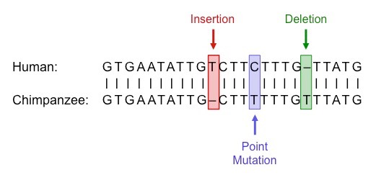
Optimal matching (OM) as one sequence alignment/comparison method
Seq of id1
Seq of id2
Substitution
Key question: How many changes do I at least have to make to make sequences A and B identical?

Slide 13
Optimal matching
OM Results:
Distance matrix between each pair of sequences
Each matrix element: total cost of aligning the two sequences using OM
Specify “costs” yourself.
Default: substitution costs = 2 * indel costs
Emphasize timing: high indel costs & low substitution costs (e.g., life transitions)
Emphasize order: low indel costs & high substitution costs (e.g., social mobility)
 | 1 | 2 | 3 | 4 | 5
1 | 0 | 2 | 20 | 4 | 5
2 | 2 | 0 | 15 | 4 | 4
3 | 20 | 15 | 0 | 8 | 9
4 | 4 | 4 | 8 | 0 | 5
5 | 5 | 4 | 9 | 5 | 0

Slide 14
Further resources
Abbott, Andrew. 1995. “Sequence Analysis: New Methods for Old Ideas.” Annual Review of Sociology 21:93–113.
Gabadinho, Alexis, Gilbert Ritschard, Nicolas S. Müller, and Matthias Studer. 2011. “Analyzing and Visualizing State Sequences inRwithTraMineR.” Journal of Statistical Software 40(4):1–37. (reproducible examples at https://www.jstatsoft.org/article/view/v040i04)
Blanchard, P., F. Bühlmann, and J. A. Gauthier. 2014. Advances in Sequence Analysis: Theory, Method, Applications. 2014th ed. edited by Philippe Blanchard, Felix Bühlmann, and J.-A. Gauthier. Basel, Switzerland: Springer International Publishing.
Cornwell, Benjamin. 2015. Social Sequence Analysis: Methods and Applications. Cambridge, England: Cambridge University Press.
Raab, Marcel, and Emanuela Struffolino. 2022. Sequence Analysis. Thousand Oaks, CA: SAGE Publications. (reproducible examples at https://sa-book.github.io/)
Sequence Analysis Workshop by Emanuela Struffolino and Anette Fasang (https://pdhp.isr.umich.edu/workshops/sequence-analysis-for-social-science/)

Slide 15
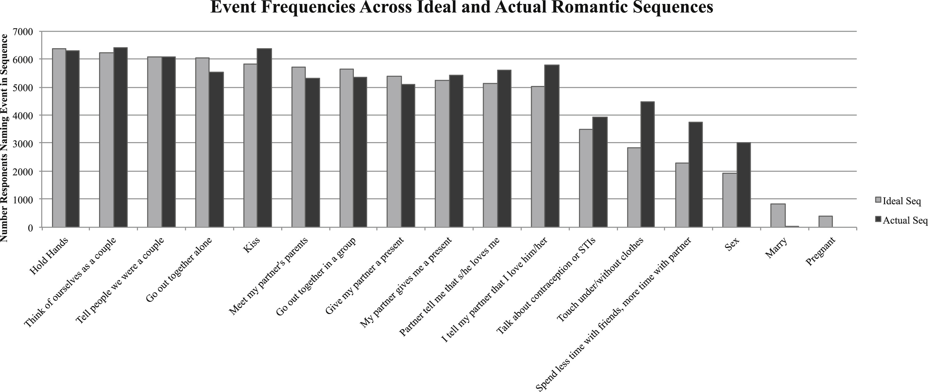
Rachel Behler 2017 “You can’t always get what you want”

